Slide 1
8 horas como desarrollador en VAIRIX

Slide 2
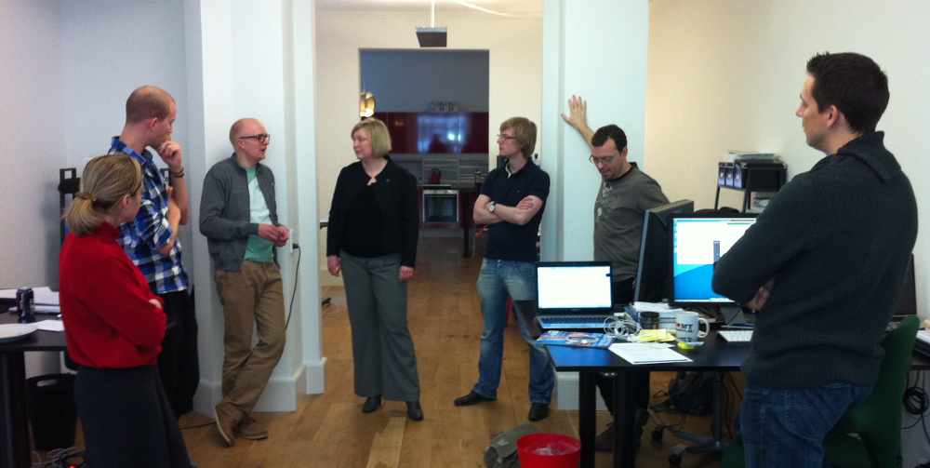
09:00 – Daily meeting

Slide 3
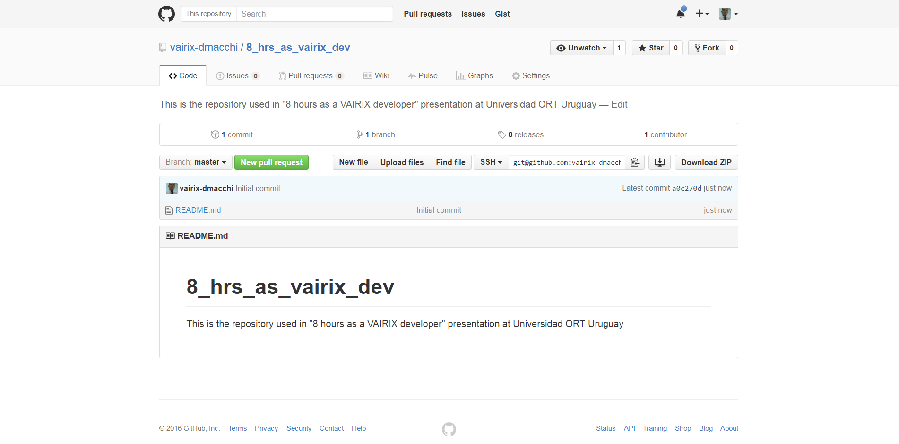
09:15 – Crear proyecto
https://github.com/vairix-dmacchi/8_hrs_as_vairix_dev

Slide 4
09:15 – Crear proyecto
git clone git@github.com:vairix-dmacchi/8_hrs_as_vairix_dev.git eight_hrs_as_vairix_dev
rails new eight_hrs_as_vairix_dev create create README.rdoc create Rakefile create config.ru create .gitignore create Gemfile create app create app/assets/javascripts/application.js create app/assets/stylesheets/application.css create …

Slide 5
09:30 – Ver status
git status On branch master our branch is up-to-date with 'origin/master'. nothing to commit, working directory clean
rails s => Booting WEBrick => Rails 4.2.4 application starting in development on http://127.0.0.1:3000 => Run `rails server -h` for more startup options => Ctrl-C to shutdown server [2016-04-05 15:36:24] INFO WEBrick 1.3.1 [2016-04-05 15:36:24] INFO ruby 2.2.1 (2015-02-26) [x86_64-linux] [2016-04-05 15:36:24] INFO WEBrick::HTTPServer#start: pid=774 port=3000 …………………………………………… …………………………………………… ……………………………………………

Slide 6
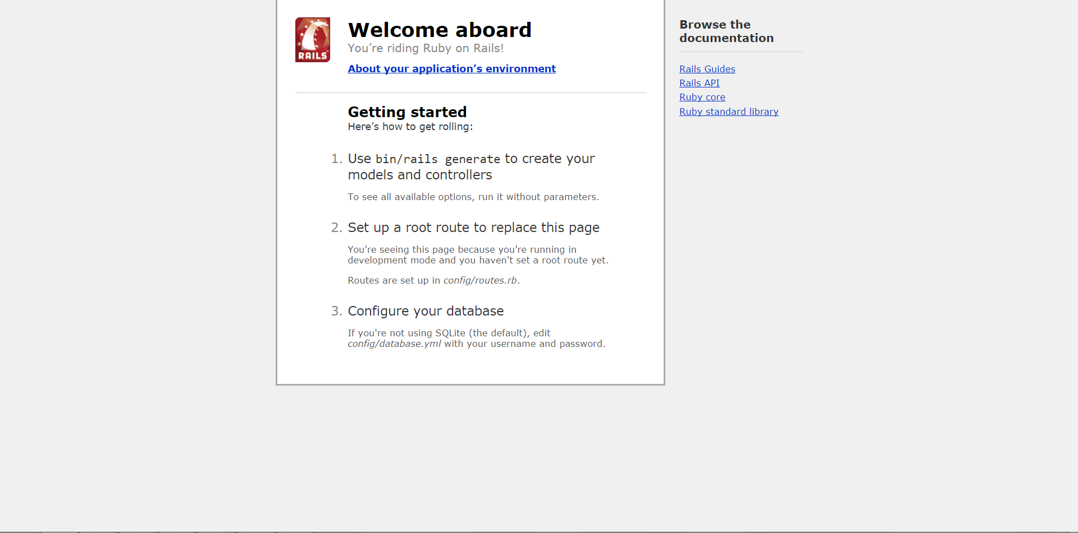
09:30 – Ver status
https://localhost:3000

Slide 7
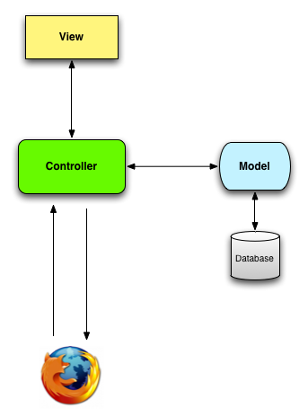
Time out – Patrón MVC

Slide 8
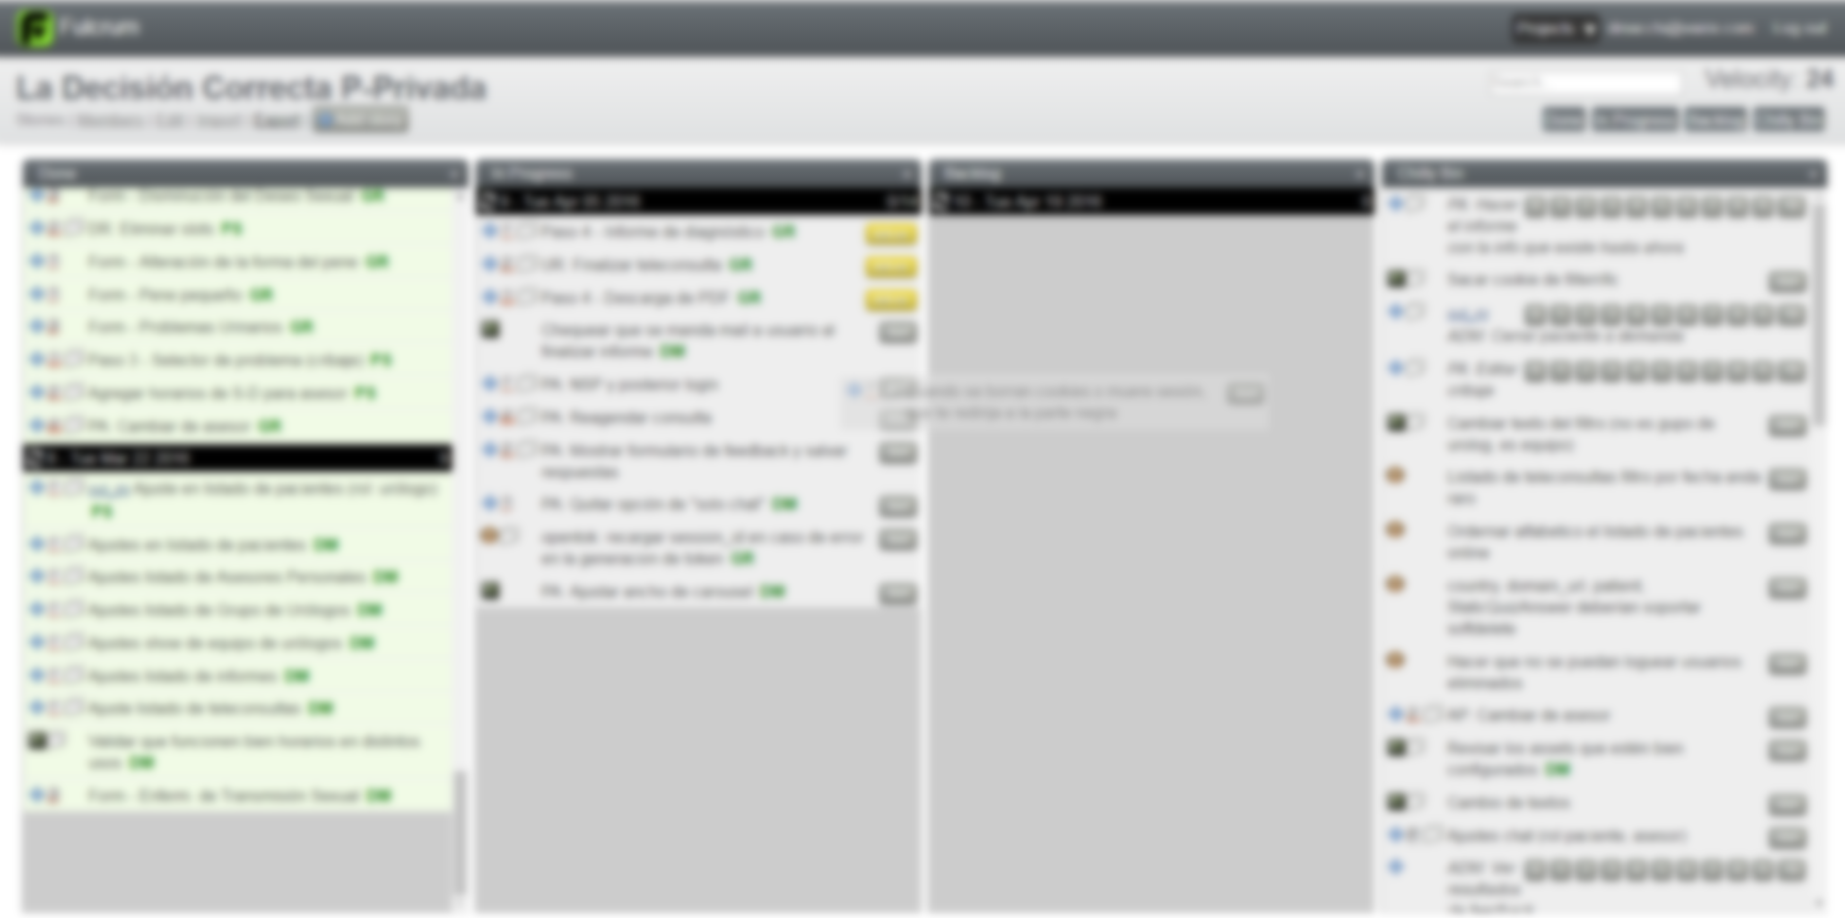
09:45 – Tomo user story de backlog

Slide 9
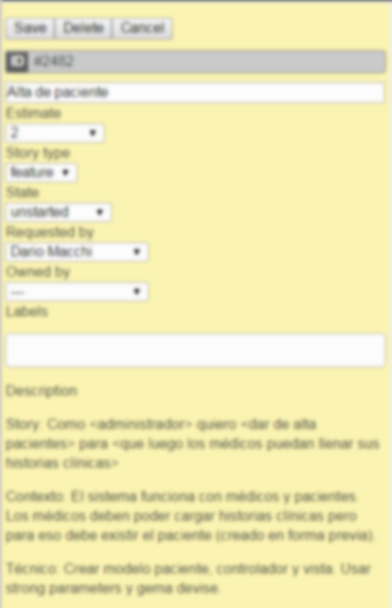
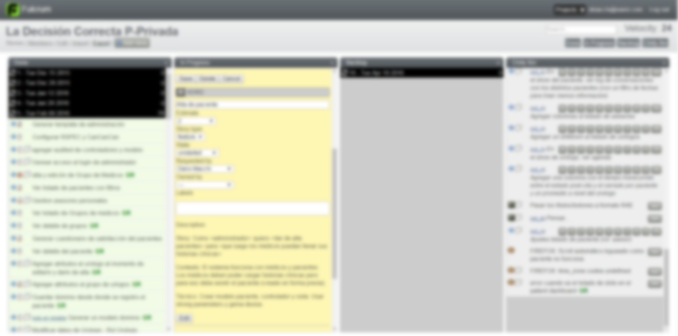
09:45 – Tomo user story de backlog
Aca va el detalle de una historia de usuario

Slide 10
09:50 – Git time! (branch)
git status ………..
git checkout –b ort_06_04_patient_crud
/8_hrs_as_vairix_dev:ort_06_04_patient_crud $

Slide 11
10:00 – “Especificar” paciente
Modelo patient
Name: string
Age: integer
Medical record: text
rails g scaffold Patient name:string age:integer medical_record:text Running via Spring preloader in process 3220 invoke active_record create db/migrate/20160405204433_create_patients.rb create app/models/patient.rb invoke test_unit create test/models/patient_test.rb create test/fixtures/patients.yml

Slide 12
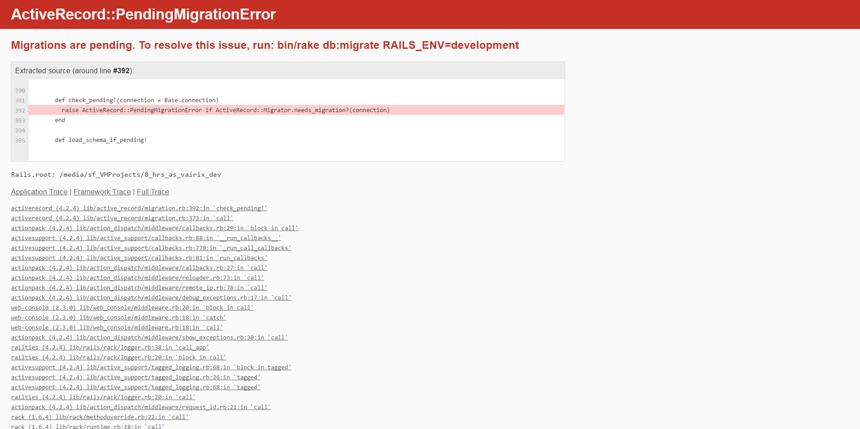
10:10 – Levantar servidor
rails s

Slide 13
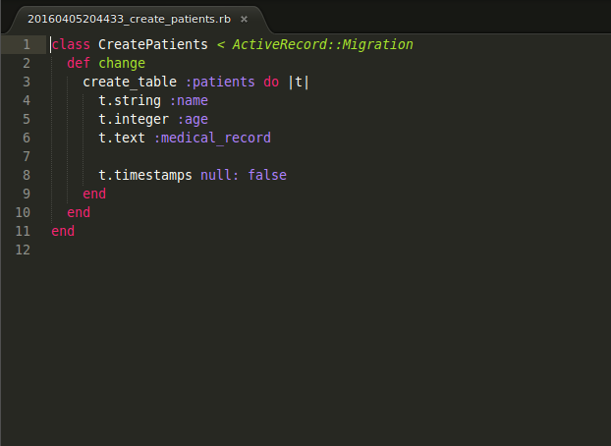
10:15 – Correr migraciones
rake db:migrate
rails s

Slide 14

10:30 – Funcionalidad lista

Slide 15
10:45 – Git time! (commit+push)
git status ………..
git add .
git commit –m”Patients CRUD+index”
git push origin ort_06_04_patient_crud

Slide 16

14:00 – Último día de sprint (retro)

Slide 17
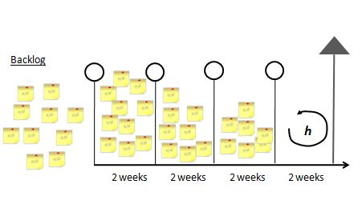

15:00 – Último día del sprint (planning)

Slide 18

18:00 – Ta mañaaaaana!

